Slide 1

Alumni Sharing The Journey of Portfolio Building

Slide 2

Kurnia Anwar Ra’if
A Highly-motivated Data Scientist
Senior Data & AI Platform - PT. Mastersystem Infotama Tbk (Des 24 - now)
Data Scientist @ PT. KitaLulus International (sept 22 - des 24)
AI / DS Mentor @ dibimbing (Apr 2022 - now)
Data Scientist @ PT. Sharing Vision– BRI Consultant (sept 21-sept 22)
Software Engineering @ PT. AILIMA Geothermal (june 20-sept 21)

Slide 3

Outline :
Impact Portfolio to get the jobs
Step by step to create portfolio
Brief Assignment pembuatan Portfolio

Slide 4
Impact Portfolio to get the jobs

Slide 5
Your personal brand is what people say about you when you are not in the room.
Portfolio = personal brand
Your personal brand encompasses the offerings you deliver; the assortment of values you advocate for; and the unique resources, skills and knowledge you bring to the table. Effective personal branding will differentiate you from the competition and allow you to build trust with prospective clients and employers.
how you see yourself
how others see you
your personal brand
Key elements of a successful personal branding:
78%
58%
48%
90%
Hiring managers think that a candidate’s social profiles are important to consider
Hiring managers think that good culture-fitness is more important than a candidate’s skills or experience
Employers use social media to check on current employees
Employers use social media to screen candidates during hiring process

Slide 6
Step by step to create portfolio

Slide 7
What can be included in your portofolio ?
1
Interactive Dashboard
2
AI/ML/DL/Gen-AI Prediction Model
3
Dataset Contribution
Anything that can proof your skills OR shows your interest.
4
Breakdown About An Algorithm

Slide 8
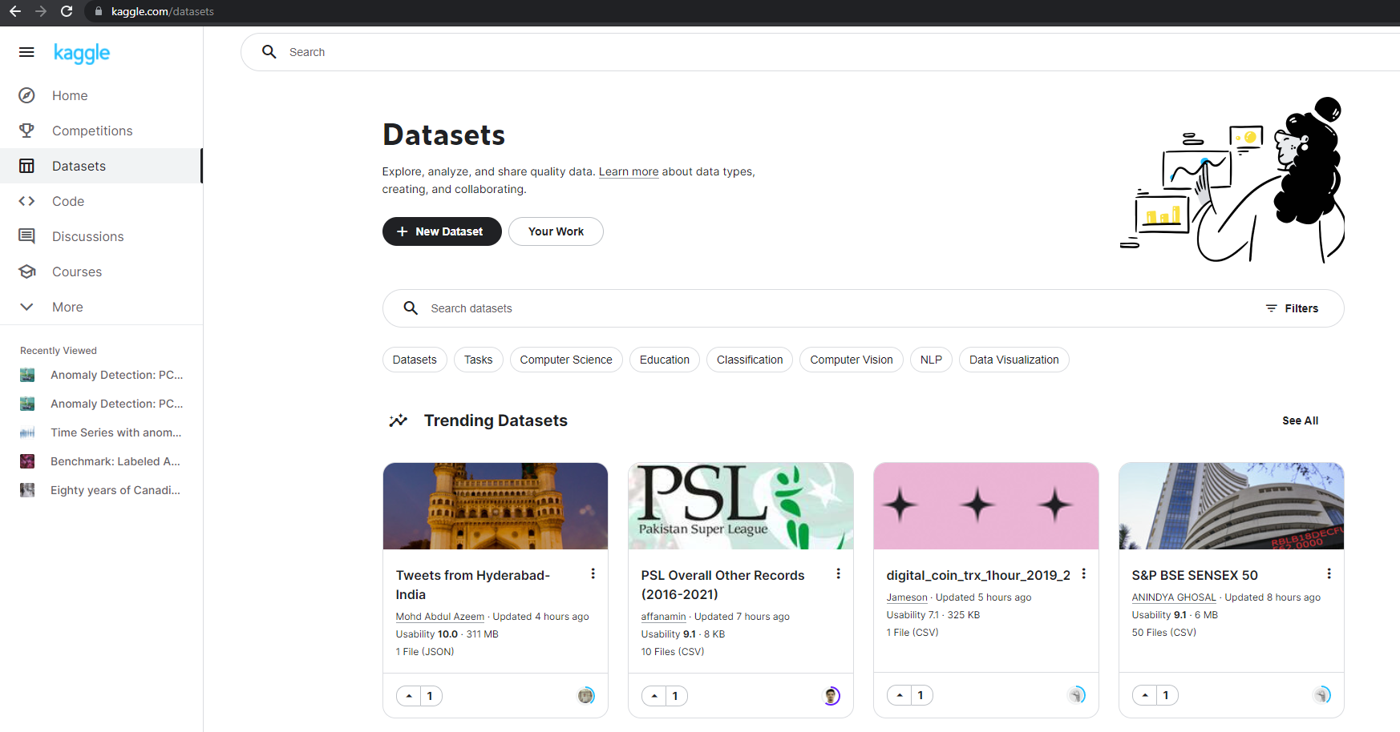
Where to find Dataset ? Kaggle Dataset or Scikit learn : (kaggle.com/datasets) or https://scikit-learn.org/1.5/datasets/toy_dataset.html

Slide 9
Tips for Upload to github repository
1. Rich README.MD
2. Clear commented code
3. Add repo tags and ‘About’ description
4. Add corresponding presentation slides if it’s necessary
where you can share your code in repository
Example Repository :
https://github.com/anwarraif/R_ExploratoryDataAnalysis

Slide 10
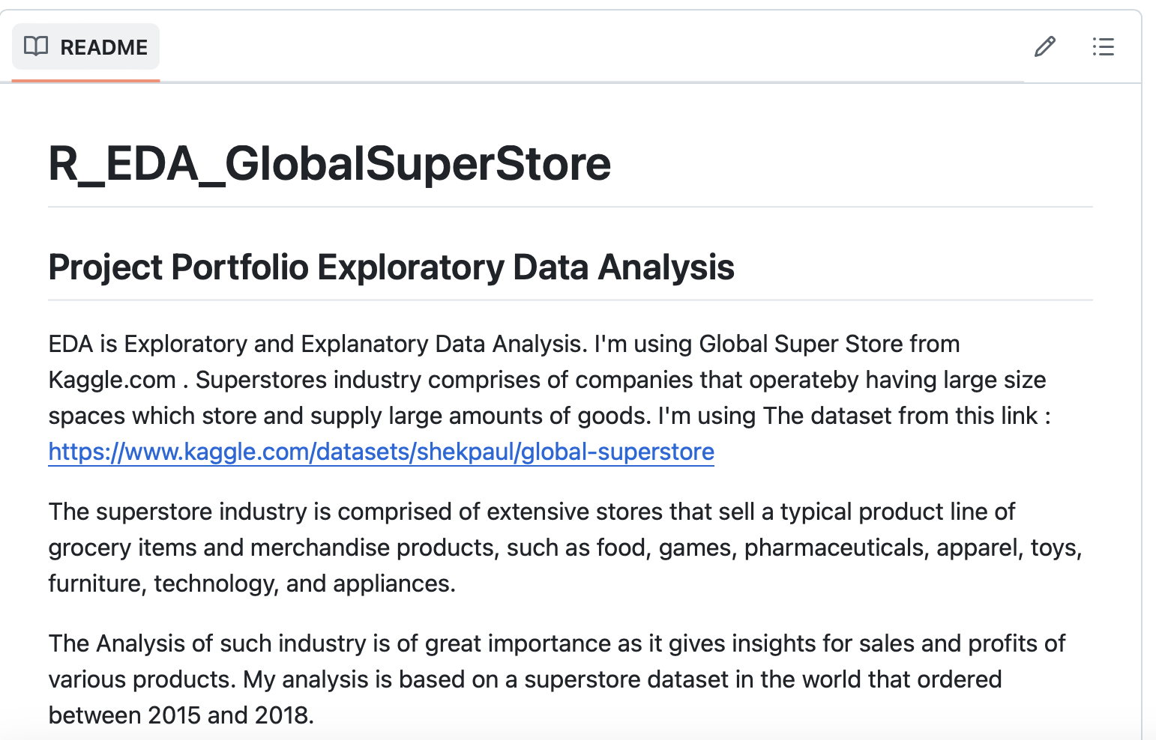
Tips for Upload to github repository
GitHub Repository
1. Rich README.MD
Project description, goals, insight dependency, advice
https://github.com/anwarraif/R_ExploratoryDataAnalysis

Slide 11
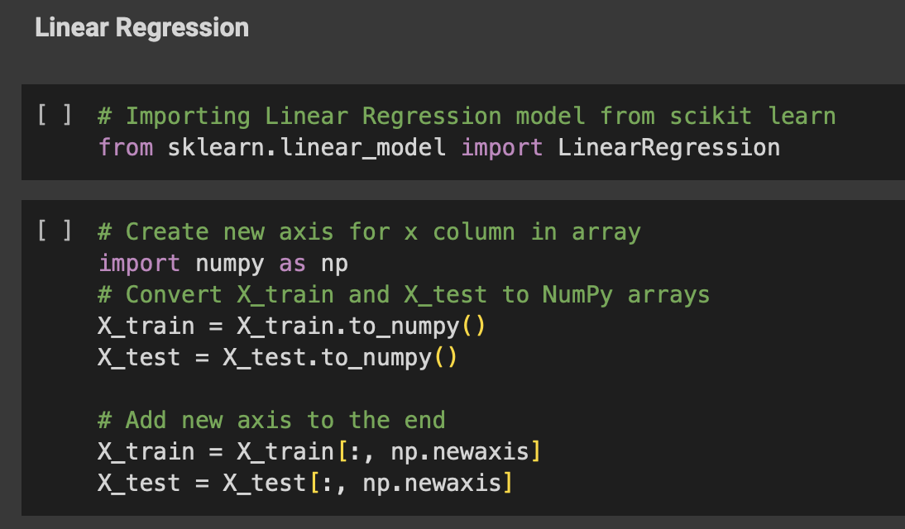
Tips for Upload to github repository
GitHub Repository
2. Clear commented code
Describe line of codes that needs further explanation

Slide 12
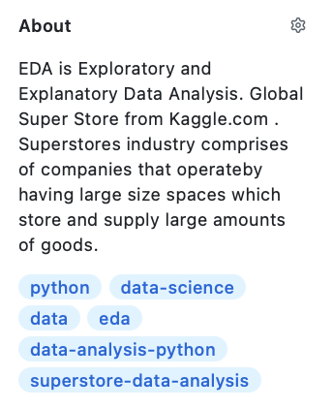
Tips for Upload to github repository
GitHub Repository
3. Add repo tags and ‘About’ description
So that your repo can be indexed and searched

Slide 13
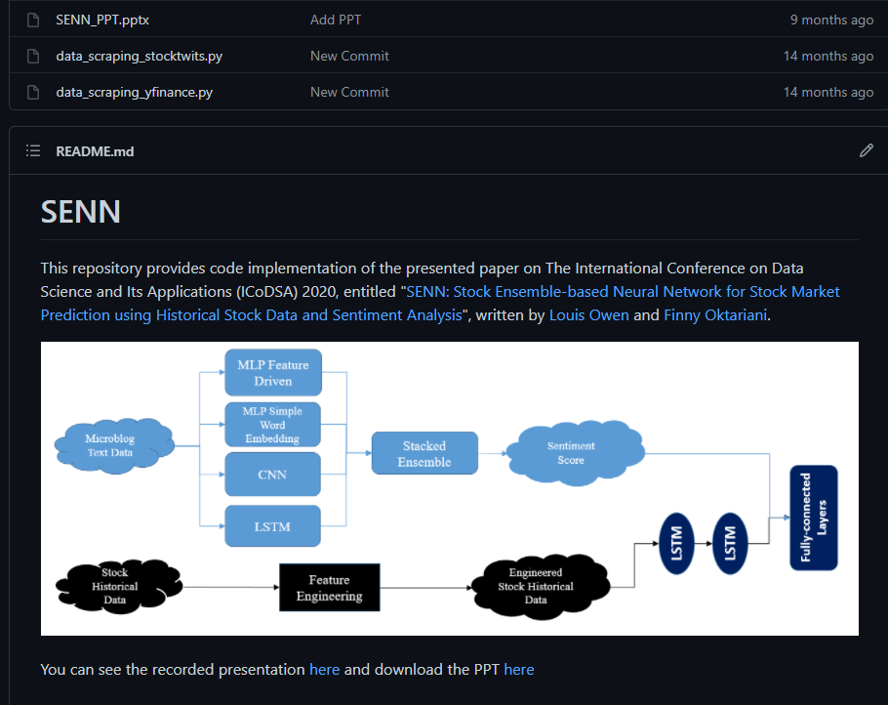
Tips for Upload to github repository
GitHub Repository
4. Add corresponding presentation slides if it’s necessary (Optional)
So that other people can see your slide-making skill as well

Slide 14
Tips publish portfolio in linkedin
1. Write the headline
2. Write descriptive yet effective content
3. Don’t make all of this about YOU
4. Never write more than 2 sentences in each paragraph
5. Provide relevant links in the comment section
6. Add only the preview of your project that can be ‘sold’
7. Add hashtags
The place where you can gain audiences for your project

Slide 15
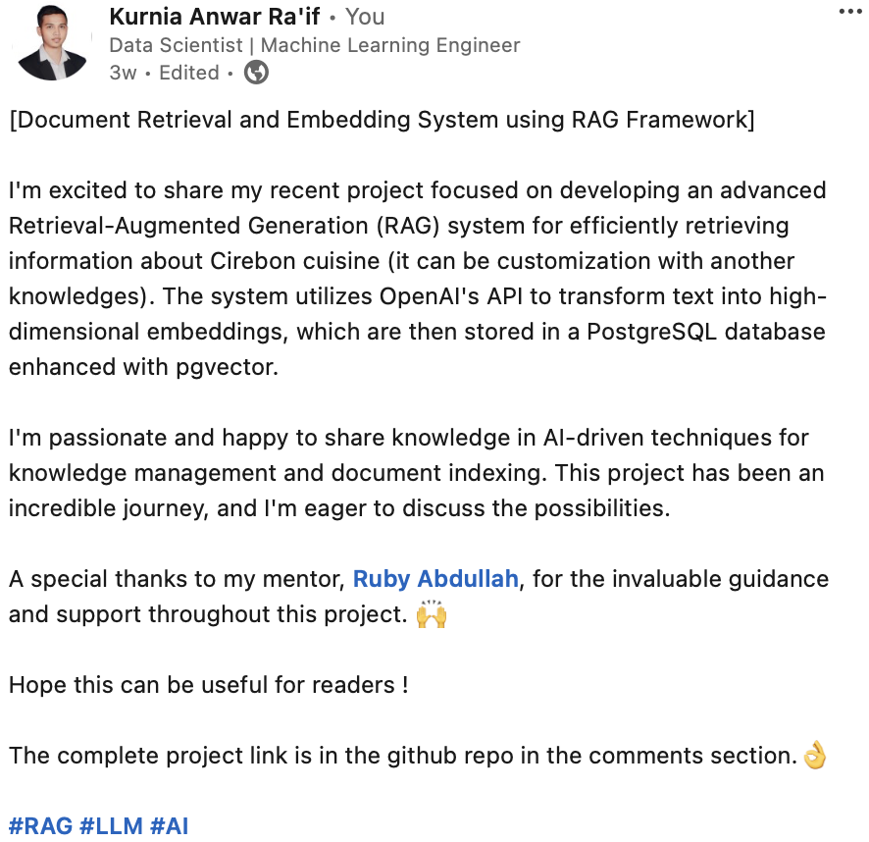
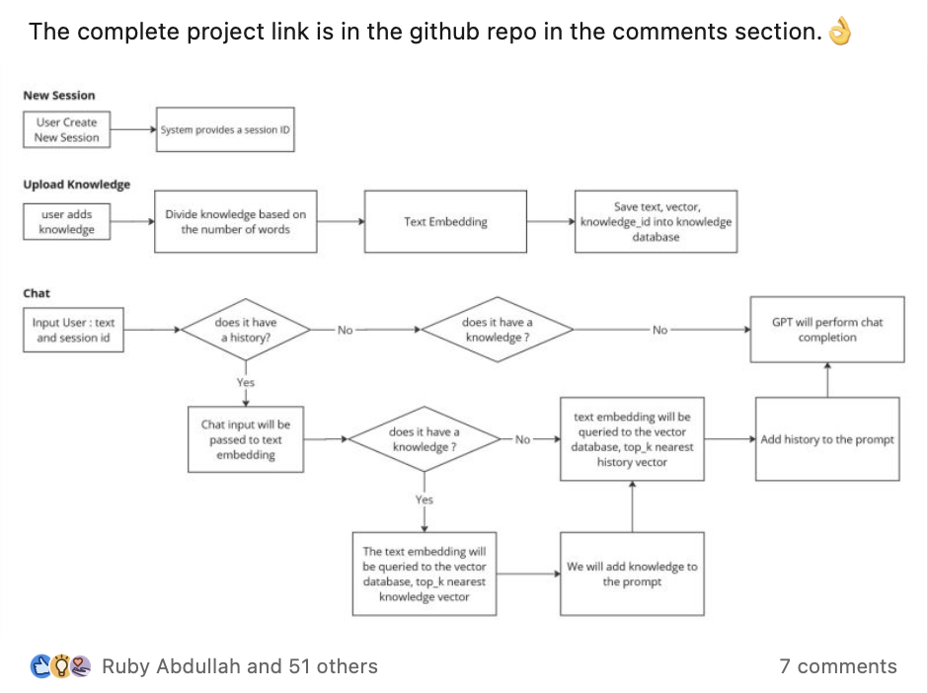
Tips publish portofolio in linkedin
LinkedIn
1. Write the headline
To deliver the key takeaways we want them to get after reading our post

Slide 16
Tips publish portofolio in linkedin
LinkedIn
2. Write descriptive yet effective content
To deliver the key takeaways we want them to get after reading our post

Slide 17
Tips publish portfolio in linkedin
LinkedIn
3. Don’t make all of this about YOU
People tend to be happier when they saw something that is beneficial for them

Slide 18
Tips publish portfolio in linkedin
LinkedIn
4. Never write more than 2 sentences in each paragraph
To keep your reader’s eye wide open

Slide 19
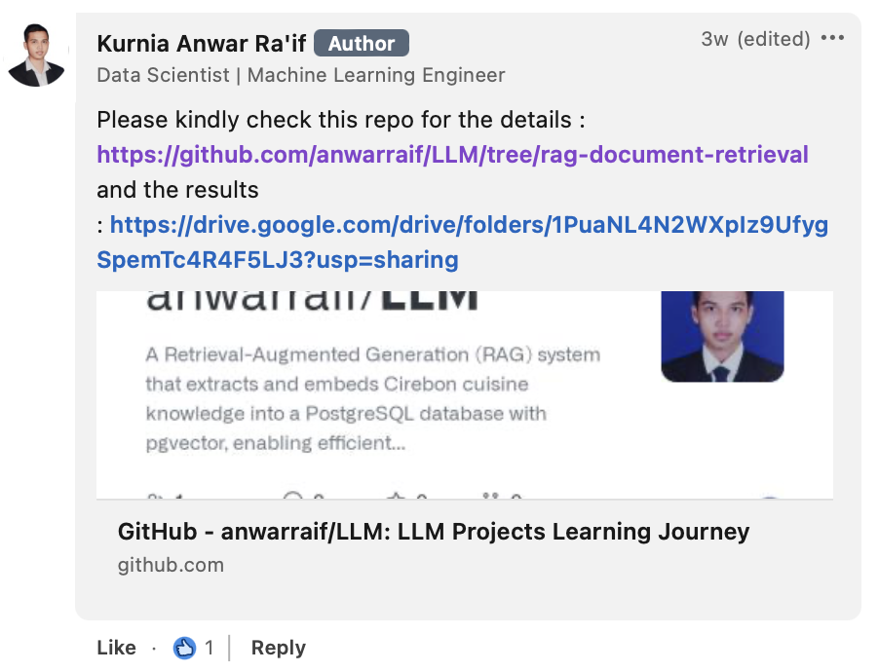
Tips publish portfolio in linkedin
LinkedIn
5. Provide relevant links in the comment section
LinkedIn’s algorithm will share your post to a broader audience when you don’t put any external link in your post body. Adding github repository link.

Slide 20
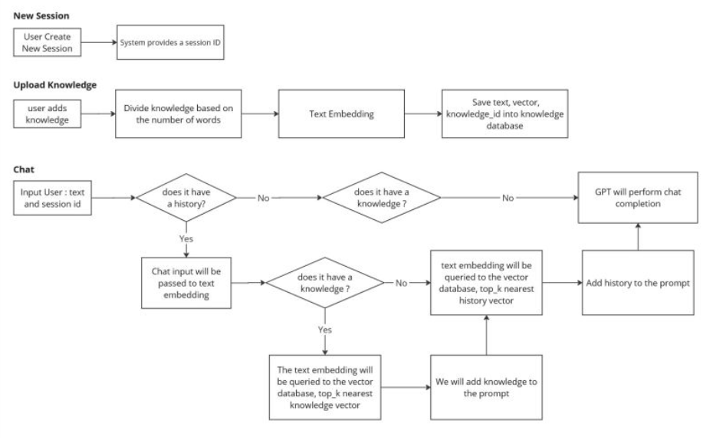
Tips publish portfolio in linkedin
LinkedIn
6. Add only the preview of your project that can be ‘sold’
Too many details is not good (Screenshot of flowchart projects or video)
referensi flowchart : https://medium.com/dot-intern/jenis-flowchart-dan-simbol-simbolnya-ef6553c53d73

Slide 21
Tips publish portfolio in linkedin
LinkedIn
7. Add hashtags
So that your post can be indexed by LinkedIn
Notes : If there are >1 images, save them in a PDF

Slide 22
Brief Assignment creating Portfolio

Slide 23
Brief Assignment creating Portfolio :
Buatlah portofolio yang di-posting ke github untuk code, dataset dan ppt yang sudah dibuat.
Share portofolio anda ke linkedin sesuai tips-tips yang diberikan beserta lampiran ppt nya (opsional) juga.

Slide 24
Q & A

Slide 25



Thank you
https://www.linkedin.com/in/anwaraif/
kurniafreelancer@gmail.com

